Slide 1
CISC2003 OOP AND DATA STRUCTURES
1
Lab 2
TA: Zhang Wenyuan
yc07421@umac.mo
E11-2016
Notes:
Chapter 1 - 1

Slide 2
Outline
7
Get familiar with classes, methods, and basic Java programming structure.
Get familiar with Package.
Get familiar with Inheritance.
Notes:
Chapter 1 - 2

Slide 3
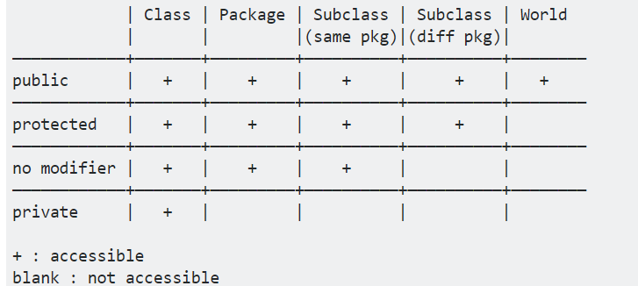
Example1: access modifiers of class
3
class E{
public static void main(String[] args) {
Example A;
A= new Example();
A.method1();
A.method2();
A.a;//unable to access
A.newMethod();
}
}
// Example and E in the same pkg
class Example{
private int a,b,c;
public Example(){}//constructor
public void method1(){}
public void method2(){}
protected void newMethod(){}
}
Notes:
Chapter 1 - 3

Slide 4
Example2: package
4
Set the path: currentFold/a/b
Save the TestT.java under: currentFold/a/b/TestT.java
Set the path: currentFold/c/d
Save the T.java under: currentFold/c/d/T.java
Compile TestT.java
Run
package a.b;
import c.d.T;
public class TestT {
public static void main(String[] args) {
T t = new T();
t.p();
}
}
package c.d;
public class T {
public void p(){
System.out.println("class：T");
}
}
Notes:
Chapter 1 - 4

Slide 5
Example3(1): inheritance
5
class Test{
public static void main(String args[]) {
int a = 20, b = 10;
Sub demo = new Sub();
demo.addition(a, b);
demo.multiplication(a, b);
}
}
class Super {
int z;
public void addition(int x, int y) {
z = x + y;
System.out.println("The sum of the given numbers:"+z);
}
}
class Sub extends Super {
public void multiplication(int x, int y) {
z = x * y;
System.out.println("The product of the given numbers:"+z);
}
}
class Father
{
}
class Son extends Father
{
}
Notes:
Chapter 1 - 5

Slide 6
Example3(2): inheritance
6
public class Penguin
{
private String name;
private int id;
public Penguin(String myName, int myid)//constructor
{
name = myName; id = myid;
}
public void eat()
{
System.out.println(name+"eatting");
}
public void sleep()
{
System.out.println(name+"sleeping");
}
public void introduction()
{
System.out.println("I’m" + id + "number" + name + ".");
}
}
public class Mouse
{
private String name;
private int id;
public Mouse(String myName, int myid)//constructor
{
name = myName; id = myid;
}
public void eat()
{
System.out.println(name+"eatting");
}
public void sleep()
{
System.out.println(name+"sleeping");
}
public void introduction()
{
System.out.println("I’m" + id + "number" + name + ".");
}
}
Notes:
Chapter 1 - 6

Slide 7
Example3(2): inheritance
7
public class Animal
{
private String name;
private int id;
public Animal(String myName, int myid)//constructor
{
name = myName; id = myid;
}
public void eat()
{
System.out.println(name+"eatting");
}
public void sleep()
{
System.out.println(name+"sleeping");
}
public void introduction()
{
System.out.println("I’m" + id + "number" + name + ".");
}
}
public class Penguin extends Animal
{
public Penguin(String myName, int myid)
{
super(myName, myid);
}
}
public class Mouse extends Animal
{
public Mouse(String myName, int myid)
{
super(myName, myid);
}
}
Notes:
Chapter 1 - 7

Slide 8
Example3(3): inheritance
8
class Animal {
void eat() {
System.out.println("animal : eat");
}
}
class Dog extends Animal {
void eat() {
System.out.println("dog : eat");
}
void eatTest() {
this.eat(); //this call the son class
super.eat(); //super call the father class
}
}
public class Test {
public static void main(String[] args) {
Animal a = new Animal();
a.eat();
Dog d = new Dog();
d.eatTest();
}
}
Notes:
Chapter 1 - 8

Slide 9
Practice(Lab1)
9
Write a short Java method that takes an integer n and returns the sum of all positive integers less than or equal to n.
Notes:
Chapter 1 - 9

Slide 10
Exercise
10
Submission Guideline
1. Please submit .java file and screenshot to UMMoodle.
2. Do not copy your classmate’s codes, otherwise both of you will lose scores.
3.Submission deadline: 11:50pm, 28/09/2022.
(It will better if you can submit at the end of this lab.)
Notes:
Chapter 1 - 10

